Slide 1


Azərbaycan Dövlət Neft və Sənaye Universiteti
Calculus
Single Variable

Slide 2
Increasing and Decreasing Functions
and
the First Derivative Test

Slide 3
In this lecture you will learn how derivatives can be used to classify relative extrema as either relative minima or relative maxima.
First, it is important to define increasing and decreasing functions.

Slide 4

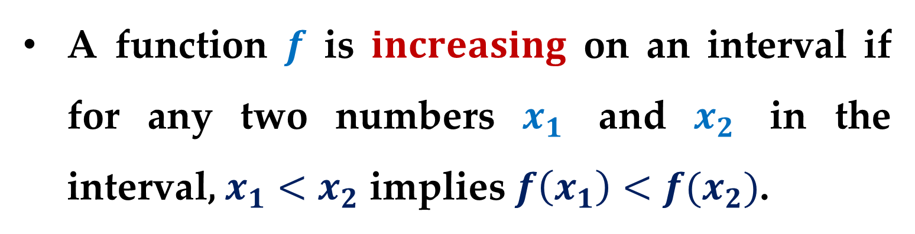
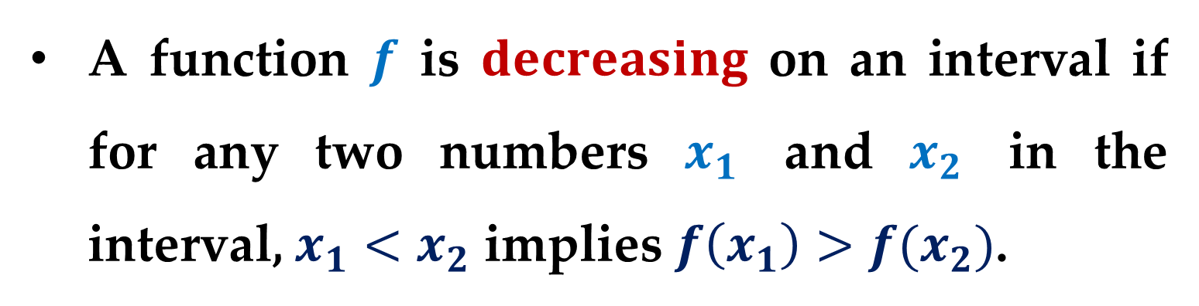
$$Definition. Increasing and Decreasing$$
$$Functions$$
A function $f$ is $increasing$ on an interval if for any two numbers $x_{1}$ and $x_{2}$ in the interval, $x_{1}<x_{2}$ implies $f\left(x_{1}\right)<f(x_{2})$.
A function $f$ is $decreasing$ on an interval if for any two numbers $x_{1}$ and $x_{2}$ in the interval, $x_{1}<x_{2}$ implies $f\left(x_{1}\right)>f(x_{2})$.

Slide 5
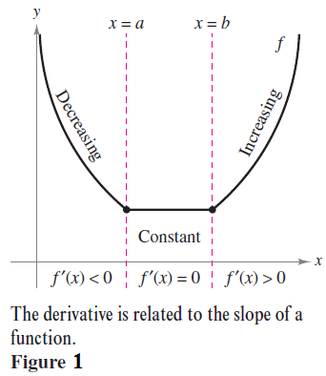
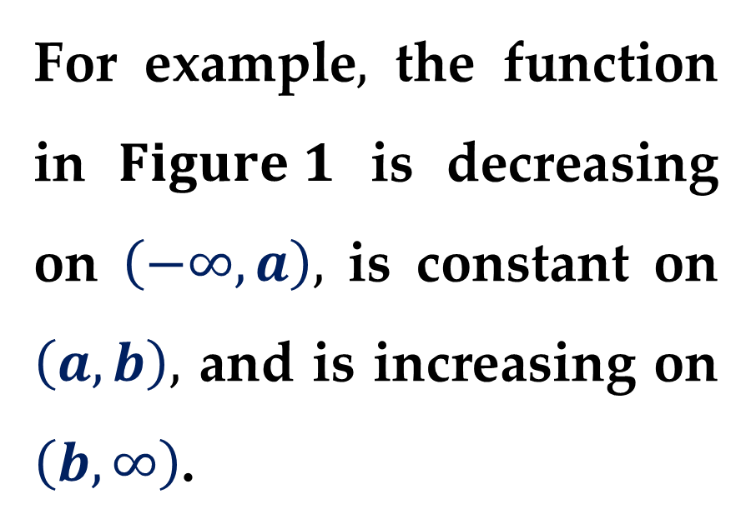
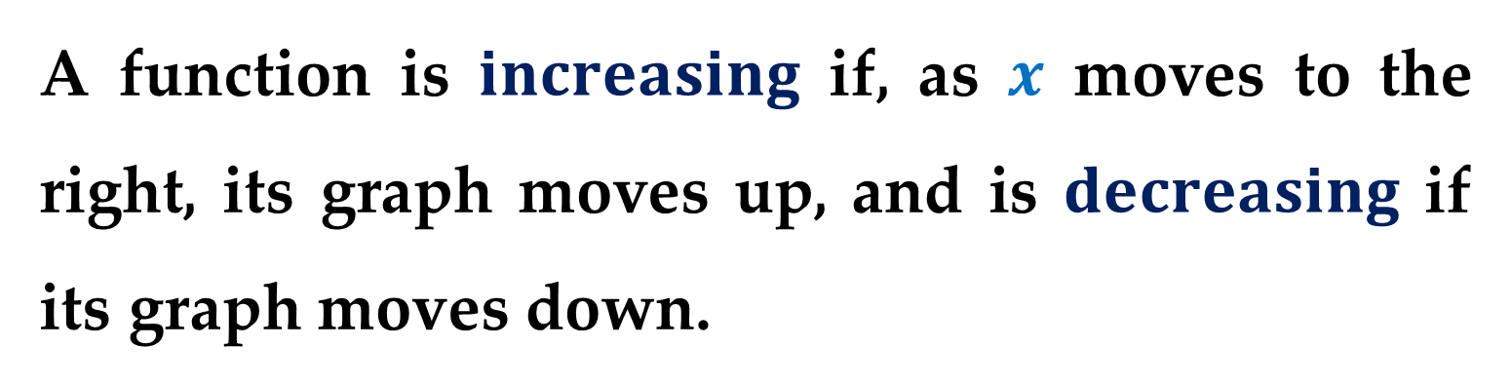
A function is $increasing$ if, as $x$ moves to the right, its graph moves up, and is $decreasing$ if its graph moves down.
For example$,$ the function in $Figure 1$ is decreasing on $\left(−∞,a\right),$ is constant on $\left(a,b\right),$ and is increasing on $\left(b,∞\right)$.

Slide 6

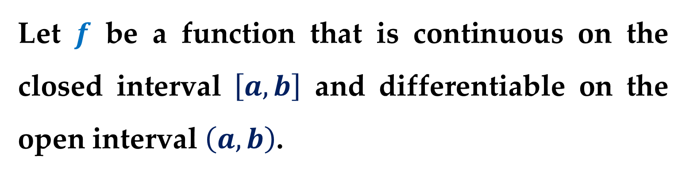
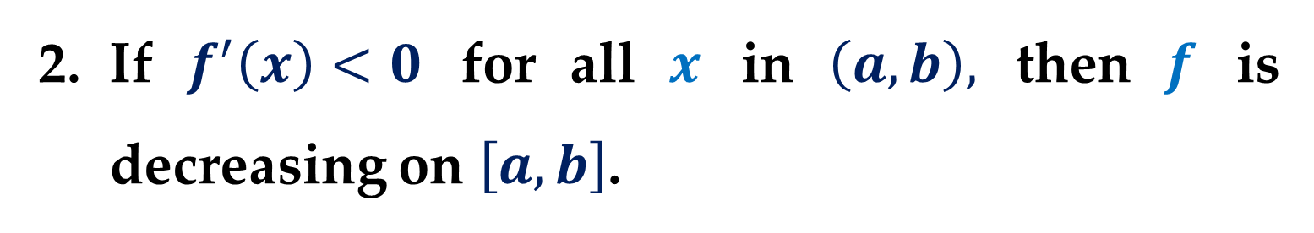
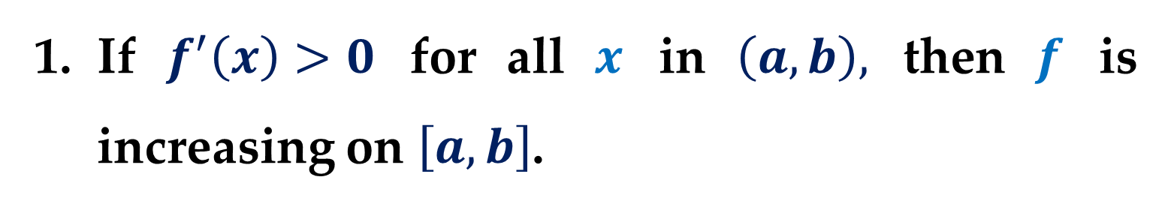
$$Theorem 5. Test for Increasing and Decreasing$$
$$Functions$$
Let $f$ be a function that is continuous on the closed interval $\left[a,b\right]$ and differentiable on the open interval $\left(a,b\right)$.
If $f^{′}\left(x\right)>0$ for all $x$ in $\left(a,b\right),$ then $f$ is increasing on $\left[a,b\right]$.
If $f^{′}\left(x\right)<0$ for all $x$ in $\left(a,b\right),$ then $f$ is decreasing on $\left[a,b\right]$.

Slide 7
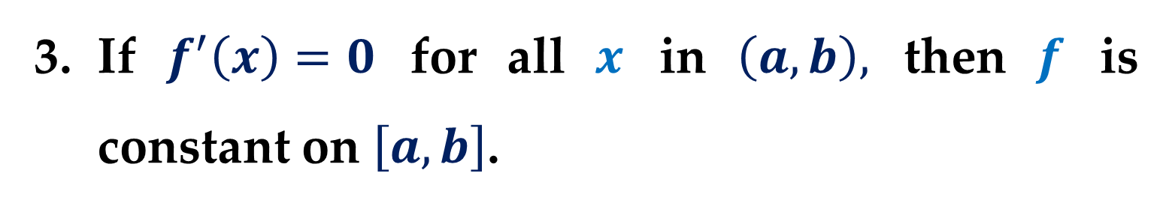
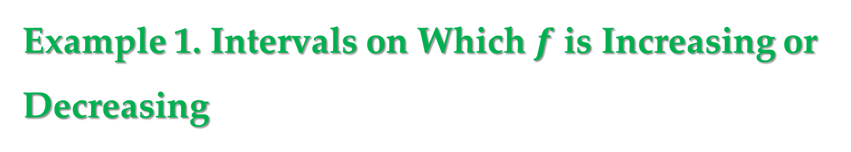

$Theorem 5. (continued)$
If $f^{′}\left(x\right)=0$ for all $x$ in $\left(a,b\right),$ then $f$ is constant on $\left[a,b\right]$.
Example 1. Intervals on Which $f$ is Increasing or Decreasing
Find the open intervals on which
$$f\left(x\right)=x^{3}−\frac{3}{2}x^{2}$$
is increasing or decreasing.

Slide 8
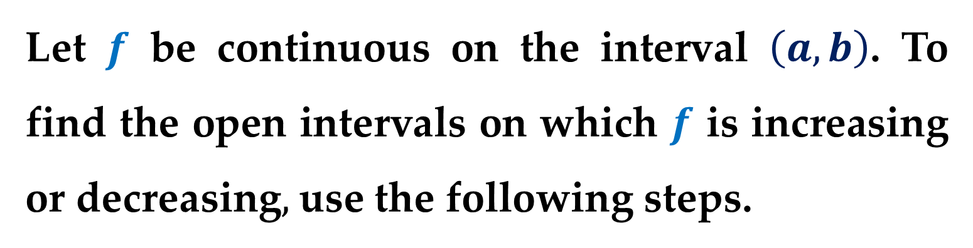

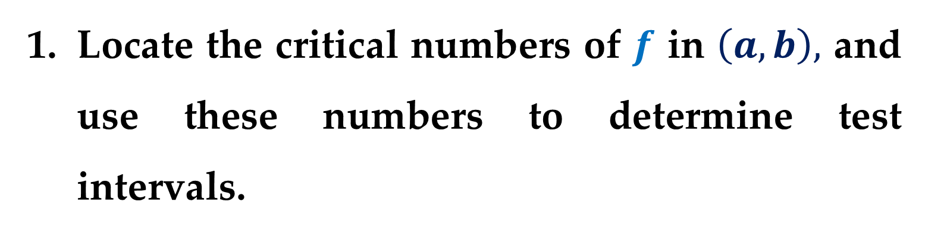
$$Guidelines for Finding Intervals on Which a$$
$$Function is Increasing or Decreasing$$
Let $f$ be continuous on the interval $\left(a,b\right)$. To find the open intervals on which $f$ is increasing or decreasing$,$ use the following steps.
Locate the critical numbers of $f$ in $\left(a,b\right),$ and use these numbers to determine test intervals.

Slide 9
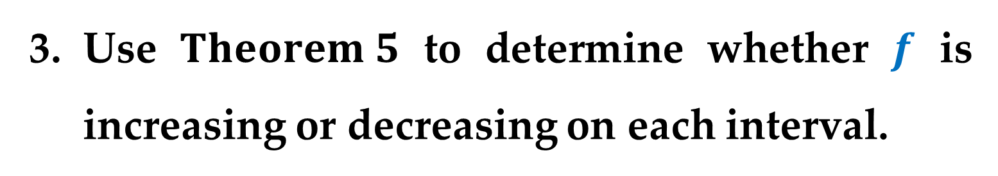
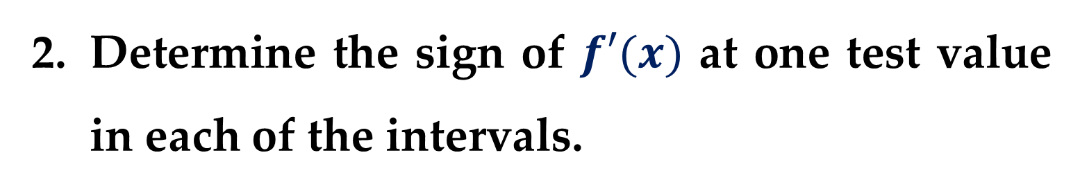

$$Guidelines for Finding Intervals on Which a$$
$$Function is Increasing or Decreasing$$
Determine the sign of $f′(x)$ at one test value in each of the intervals.
Use $Theorem 5$ to determine whether $f$ is increasing or decreasing on each interval.

Slide 10
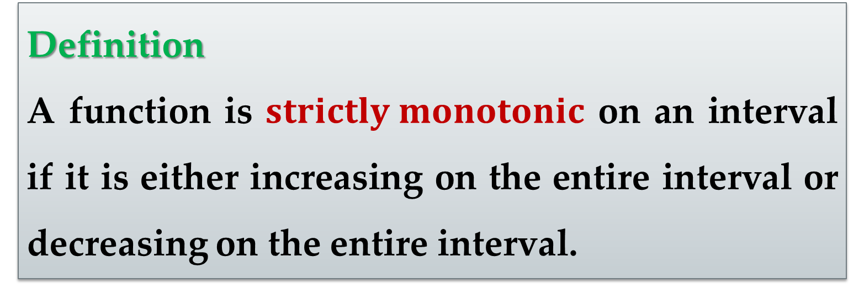
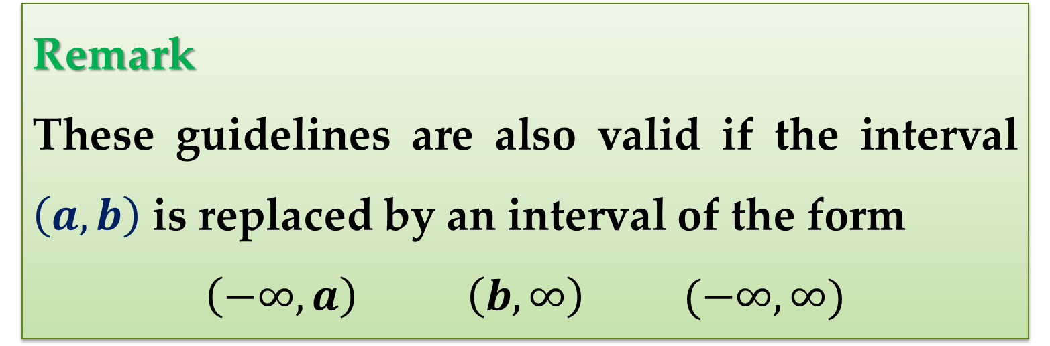
Remark
These guidelines are also valid if the interval $\left(a,b\right)$ is replaced by an interval of the form
$$\left(−∞,a\right) \left(b,∞\right) (−∞,∞)$$
Definition
A function is $strictly monotonic$ on an interval if it is either increasing on the entire interval or decreasing on the entire interval.

Slide 11
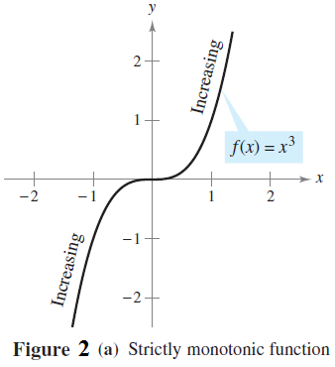
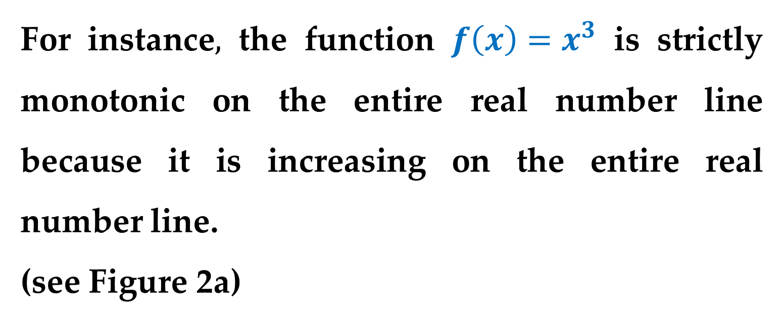
For instance$,$ the function $f\left(x\right)=x^{3}$ is strictly monotonic on the entire real number line because it is increasing on the entire real number line.
(see Figure 2a)

Slide 12
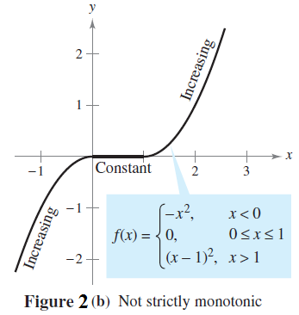
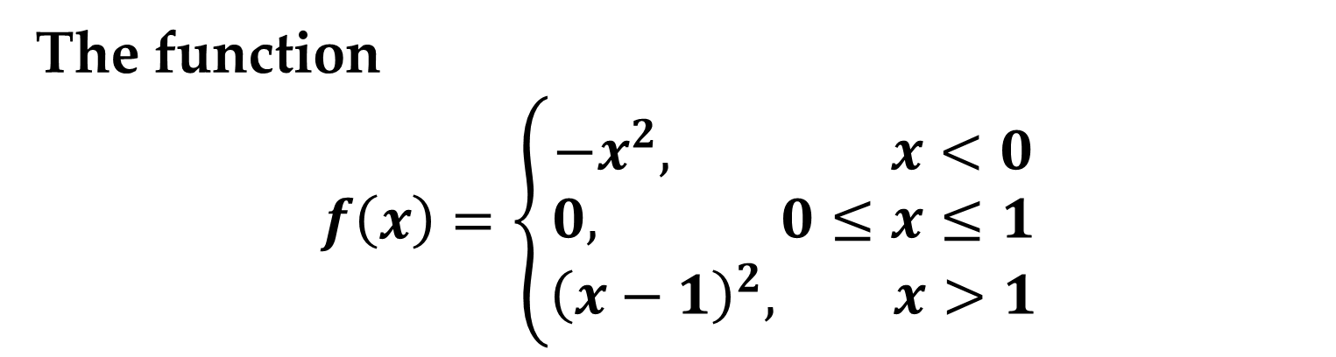
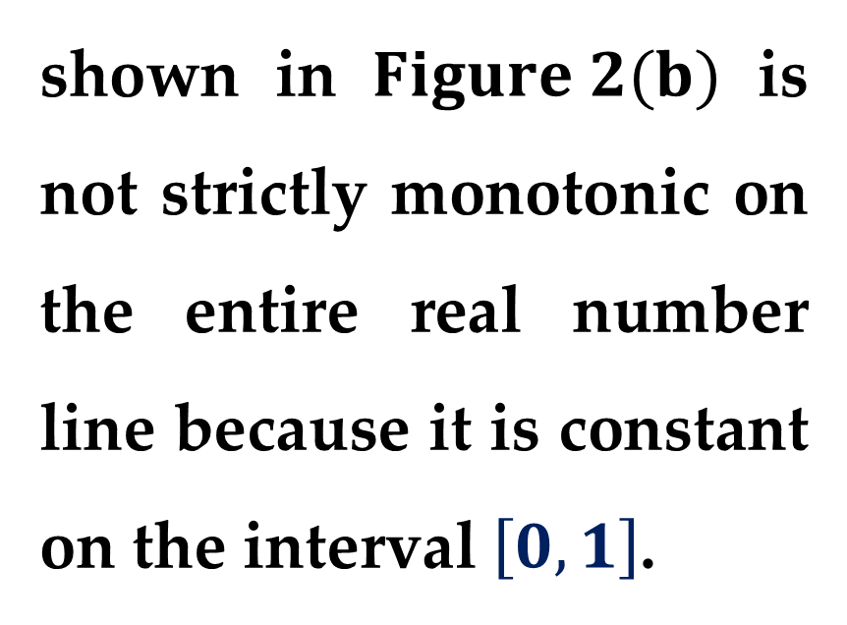
The function
$$f\left(x\right)=\left\{\begin{matrix}−x^{2}, x<0 \\ 0, 0≤x≤1 \\ {\left(x−1\right)}^{2}, x>1\end{matrix}\right.$$
shown in $Figure 2(b)$ is not strictly monotonic on the entire real number line because it is constant on the interval $\left[0,1\right]$.

Slide 13
First Derivative Test

Slide 14
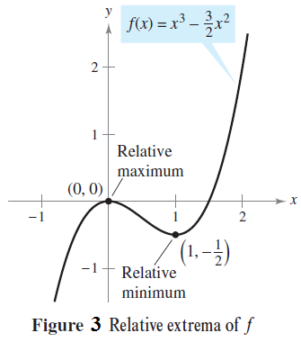
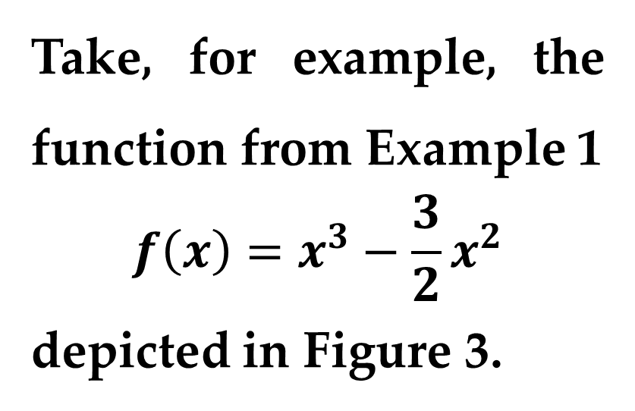
After you have determined the intervals on which a function is increasing or decreasing, it is not difficult to locate the relative extrema of the function.
Take, for example, the function from Example 1
$$f\left(x\right)=x^{3}−\frac{3}{2}x^{2}$$
depicted in Figure 3.

Slide 15
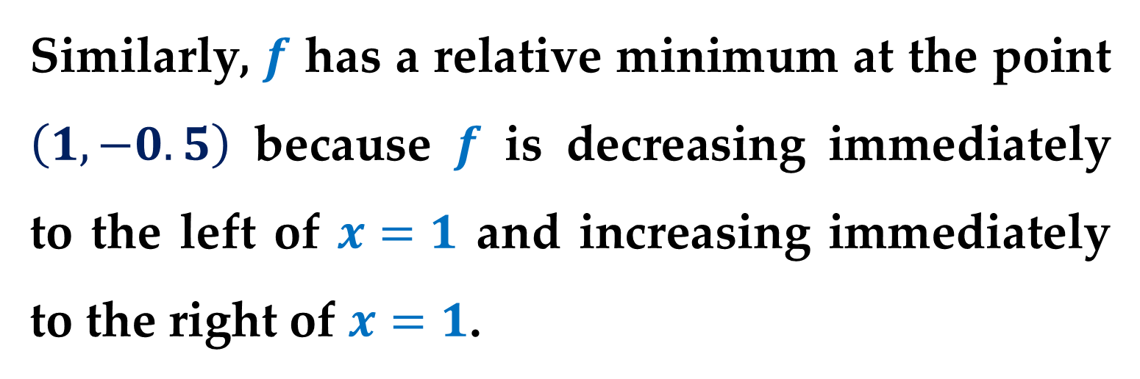
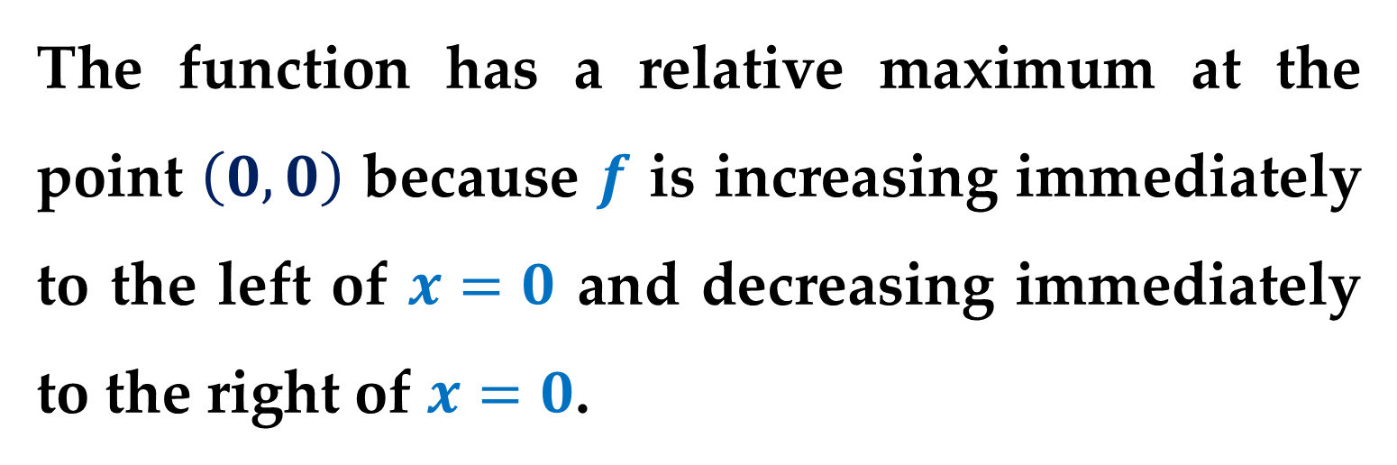
The function has a relative maximum at the point $\left(0,0\right)$ because $f$ is increasing immediately to the left of $x=0$ and decreasing immediately to the right of $x=0$.
Similarly, $f$ has a relative minimum at the point $\left(1,−0.5\right)$ because $f$ is decreasing immediately to the left of $x=1$ and increasing immediately to the right of $x=1$.

Slide 16
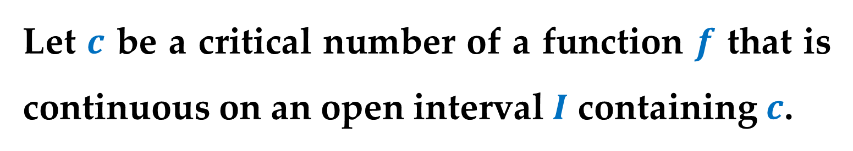
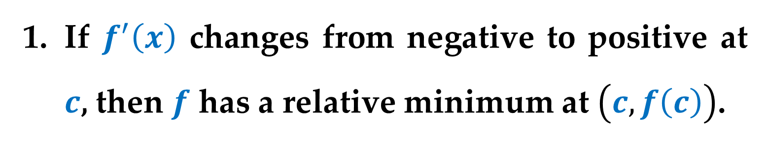
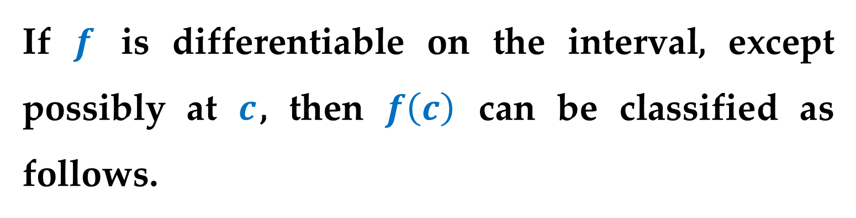
$$Theorem 6. The First Derivative Test$$
Let $c$ be a critical number of a function $f$ that is continuous on an open interval $I$ containing $c$.
If $f$ is differentiable on the interval, except possibly at $c$, then $f\left(c\right)$ can be classified as follows.
If $f^{′}\left(x\right)$ changes from negative to positive at $c$, then $f$ has a relative minimum at $\left(c,f\left(c\right)\right)$.

Slide 17

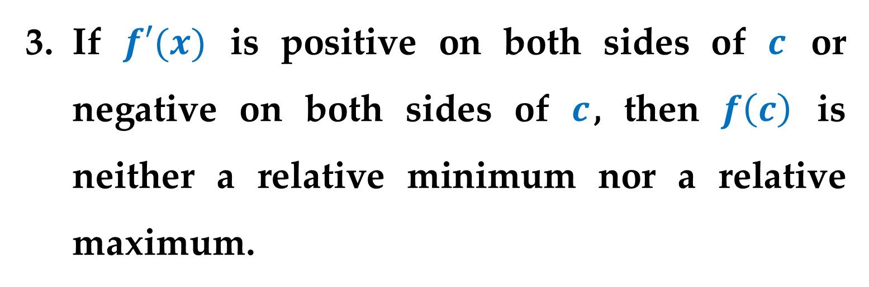
$$Theorem 6. The First Derivative Test$$
If $f^{′}\left(x\right)$ changes from positive to negative at $c$, then $f$ has a relative maximum at $\left(c,f\left(c\right)\right)$.
If $f′(x)$ is positive on both sides of $c$ or negative on both sides of $c$, then $f\left(c\right)$ is neither a relative minimum nor a relative maximum.

Slide 18
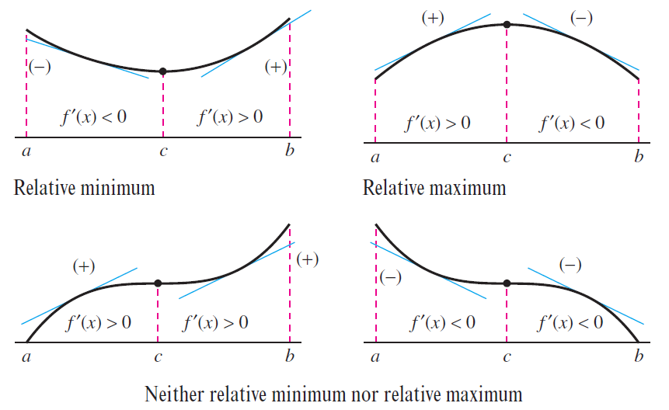

Slide 19
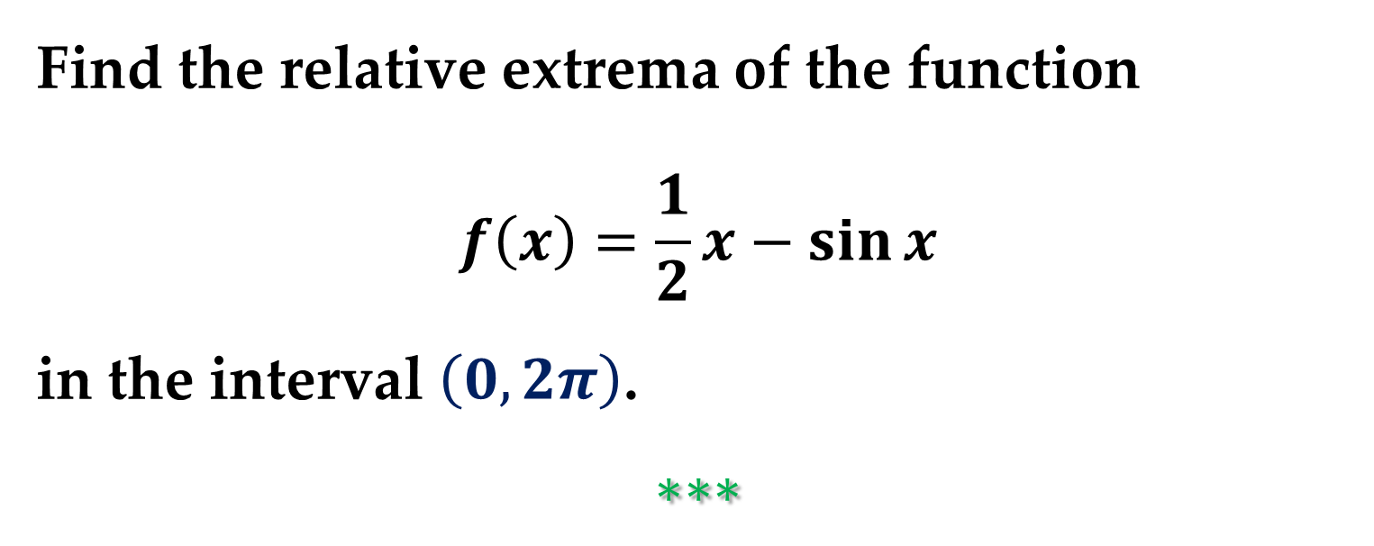
Example 2. Applying the First Derivative Test
Find the relative extrema of the function
$$f\left(x\right)=\frac{1}{2}x−\sin{x}$$
in the interval $\left(0,2π\right)$.
$$∗∗∗$$

Slide 20
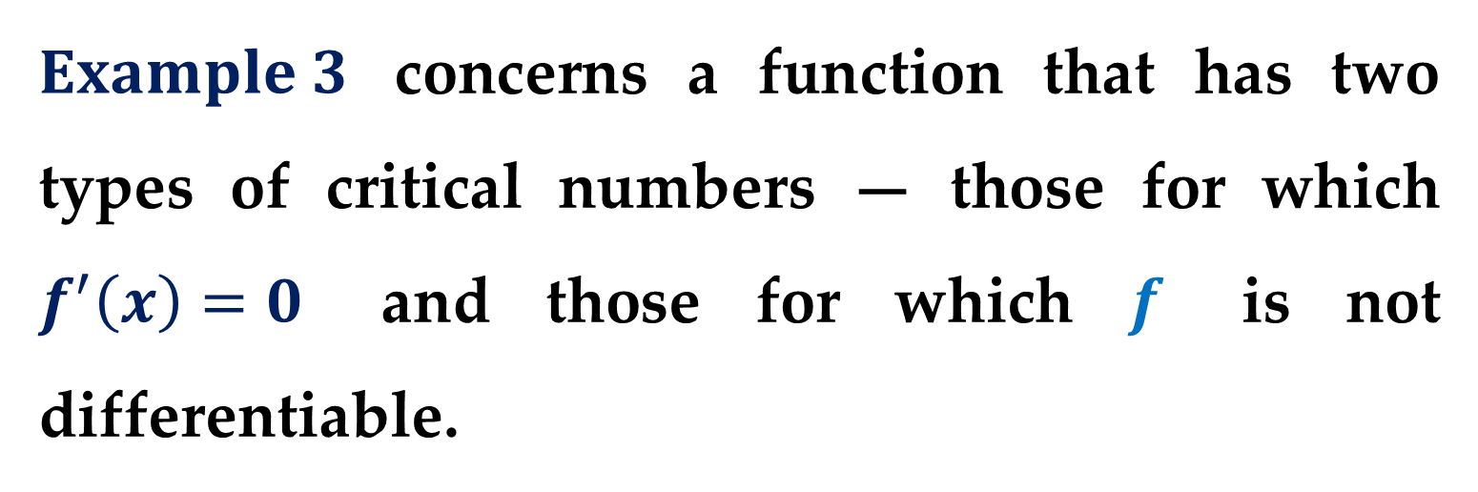
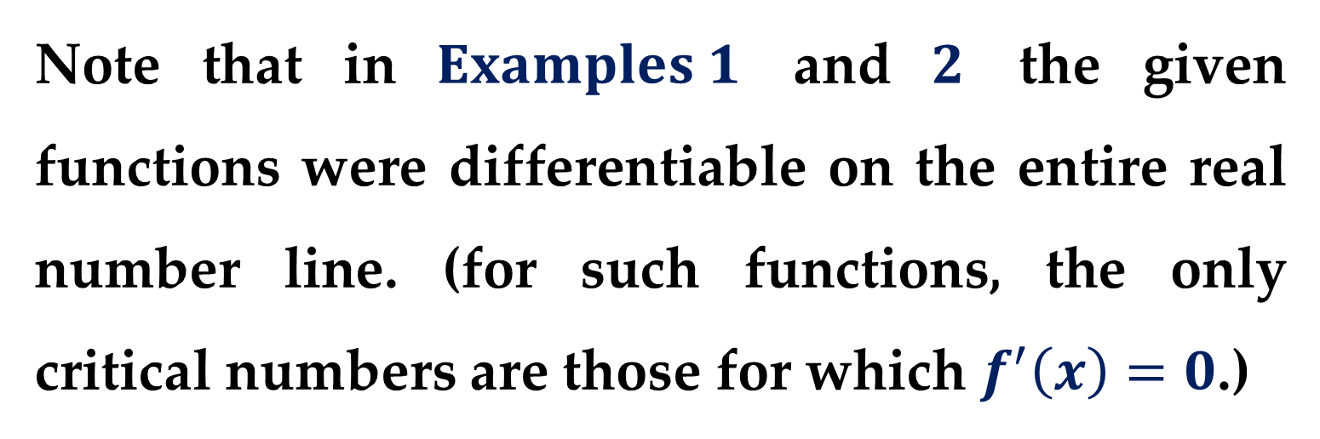
Note that in $Examples 1$ and $2$ the given functions were differentiable on the entire real number line. (for such functions, the only critical numbers are those for which $f^{′}\left(x\right)=0$.)
$Example 3$ concerns a function that has two types of critical numbers — those for which $f^{′}\left(x\right)=0$ and those for which $f$ is not differentiable.

Slide 21

Example 3. Applying the First Derivative Test
Find the relative extrema of
$$f\left(x\right)={\left(x^{2}−4\right)}^{\frac{2}{3}}$$
$$∗∗∗$$

Slide 22
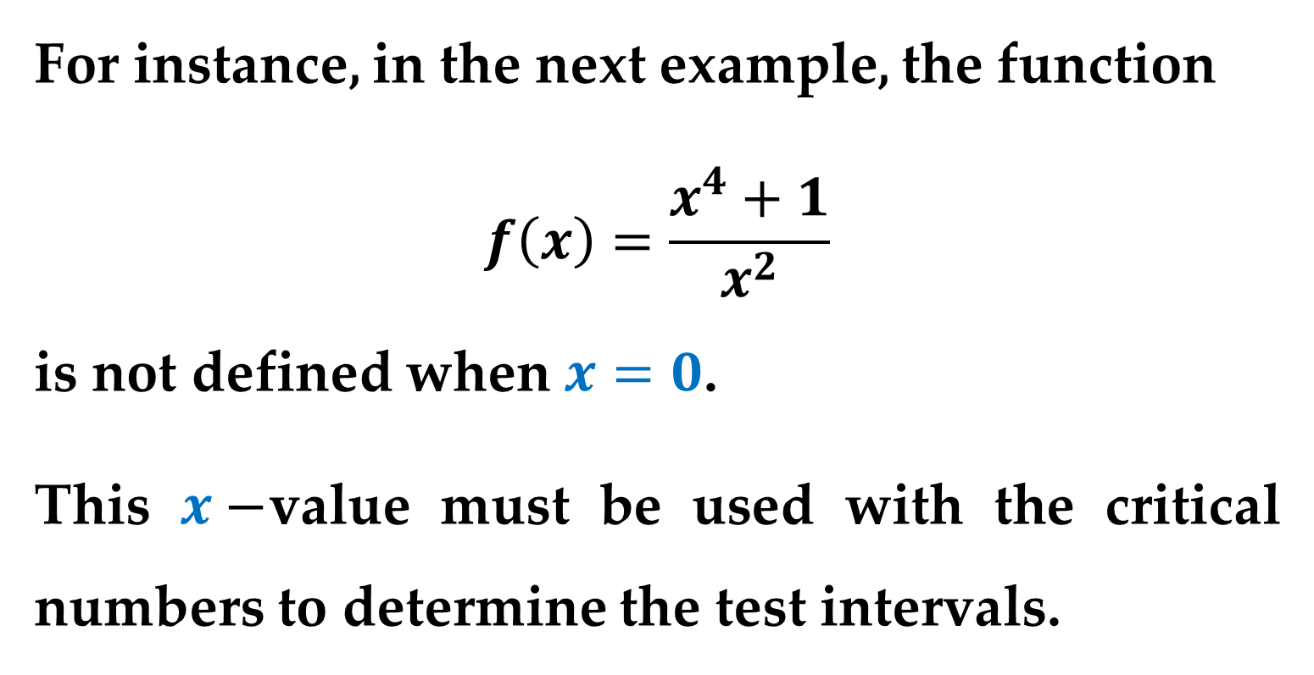
When using the First Derivative Test, be sure to consider the domain of the function.
For instance, in the next example, the function
$$f\left(x\right)=\frac{x^{4}+1}{x^{2}}$$
is not defined when $x=0$.
This $x−$value must be used with the critical numbers to determine the test intervals.

Slide 23

Example 4. Applying the First Derivative Test
Find the relative extrema of
$$f\left(x\right)=\frac{x^{4}+1}{x^{2}}$$
$$∗∗∗$$

Slide 24
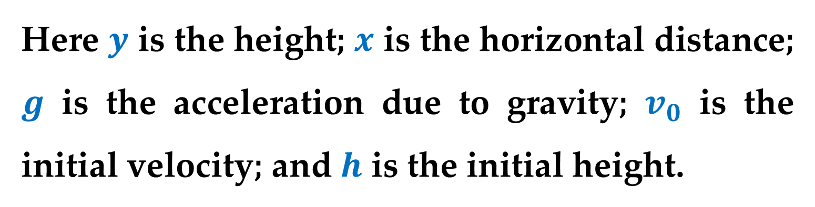
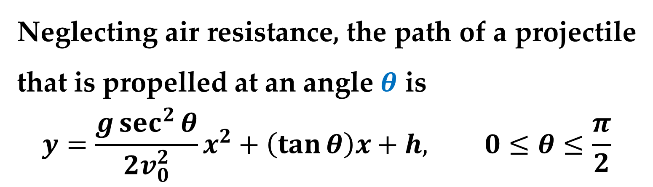
Example 5. The Path of a Projectile
Neglecting air resistance, the path of a projectile that is propelled at an angle $θ$ is
$$y=\frac{g\sec^{2}{θ}}{2v_{0}^{2}}x^{2}+\left(\tan{θ}\right)x+h, 0≤θ≤\frac{π}{2}$$
Here $y$ is the height; $x$ is the horizontal distance; $g$ is the acceleration due to gravity; $v_{0}$ is the initial velocity; and $h$ is the initial height.

Slide 25
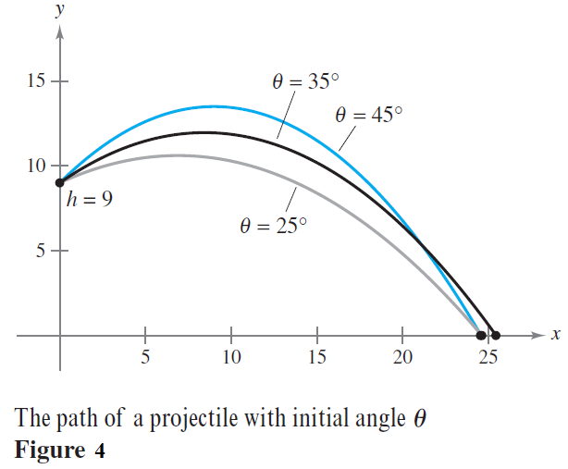
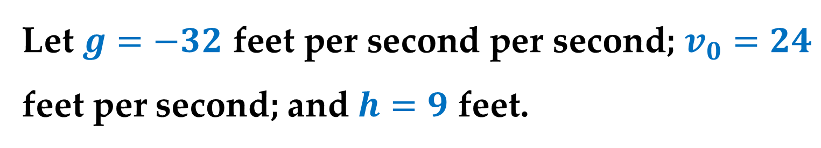
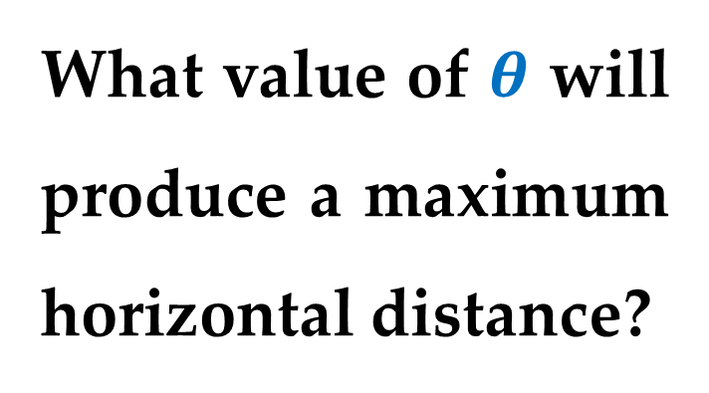
Example 5. (continued)
Let $g=−32$ feet per second per second; $v_{0}=24$ feet per second; and $h=9$ feet.
What value of $θ$ will produce a maximum horizontal distance?

Slide 26
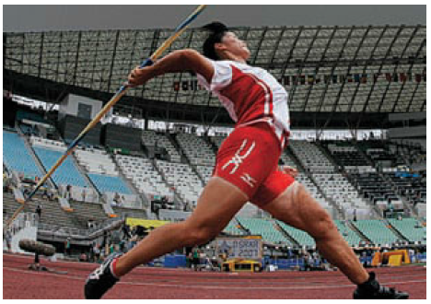
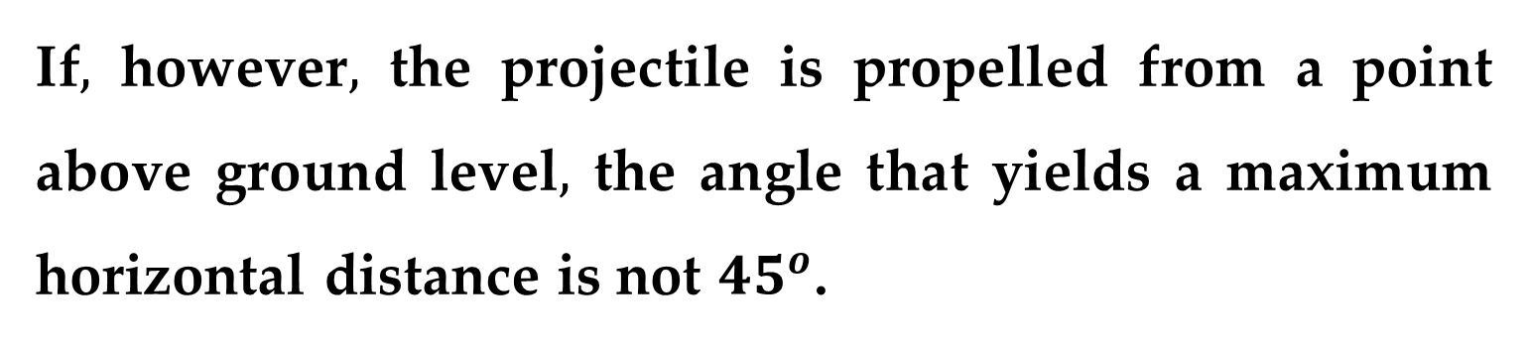
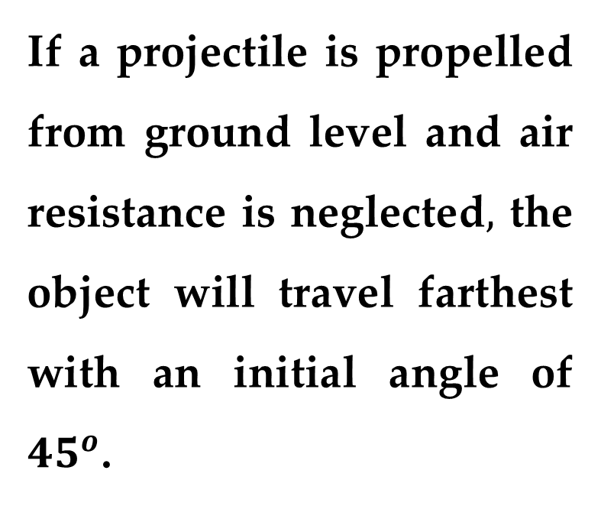
Remark
If a projectile is propelled from ground level and air resistance is neglected$,$ the object will travel farthest with an initial angle of ${45}^{o}$.
If$,$ however$,$ the projectile is propelled from a point above ground level$,$ the angle that yields a maximum horizontal distance is not ${45}^{o}$.

Slide 27
Thank you for attention

